Slide 1
Deep Photo Style Transfer
Paper ID: 54
NNFL Term Project 2019-20
2017A7PS0122P Rohit Jain
2017A7PS0088P Vaishnavi Kotturu
2017A3PS0267P Khushi Gupta

Slide 2
About the Paper
Introduces a deep-learning approach to transfTer the style of a reference style photo into another picture. The style could mean
Different illuminatiions
Time of the day
Weather etc
Why deep-learning approach?
Handle large variety of image content
Accurately transfer the style
The paper is built upon the Neural Style Transfer which suffers from problems like unrealistic images and wiggly boundaries.

Slide 3
Objective of the paper
Build a deep neural network that should-
Prevent spatial distortion and transfers only in color space.
Solution: The authors use a transformational model called Matting Laplacian that is locally affine in colorspace.
Avoid differences in content spillovers.
Solution: The approach adopted to address this issue is semantic segmentation.

Slide 4
Challenges
Structure preservation
The local drastic effects are desired but that should not distort edges and regular patterns. Thus we need to transfer only the image effect and not the geometric effect.
Semantic Accuracy and transfer faithfulness
The model should respect the semantics of the scene. Thus, the approach incorporated semantic labelling so that transfer happens between semantically equivalent sub regions.

Slide 5
Methodology
The methodology attempts to transfer the style of a stylized and retouched image (Style Image) to an ordinary photograph (Content Image) to give a photorealistic image (Output Image)
The approach attempts to modify the traditional approach of Neural Style Transfer by introducing two more concepts:
Augmented Style Loss with Semantic Segmentation
Photorealism Regularization

Slide 6
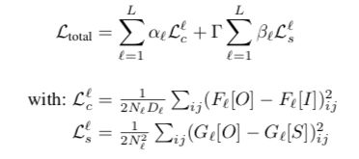
Neural Style Algorithm by Gatys. Et. al.
Transfers the reference style image ‘S’ onto the input image ‘I’ to produce an output image ‘O’ by minimizing the objective function:
where
L = total number of convolutional layers
l = l-th convolutional layer of the deep convolutional neural network.
N = no. of filters in each layer, each with a vectorized feature map of size D
F[·] ∈ R N×D = feature matrix with (i, j) indicating its index
Gram matrix G[·] = F[·]F[·] T ∈ R N×N
α and β= weights to configure layer preferences
Γ = weight that balances the tradeoff between the content and the style

Slide 7
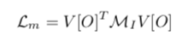
Photorealism Regularization
Augments the constraint of preserving the structure of the input image and and avoids the content-mismatch problem. This strategy expresses this constraint on the transformation that is applied to the input image.
Aim: Do not lose the photorealism property during the transfer by loaclly affining in the color space and allowing spatial variations.
Solution: achieved using Matting Laplacian.
where V [O] = the vectorized version of the output image O
MI = least square penalties
Lm = locally affine transform

Slide 8
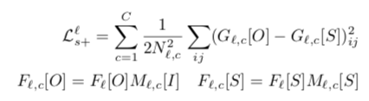
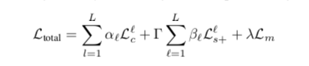
Augmented Style Loss
In neural style, Gram matrix is computed over entire image. Instead, use a technique akin to Neural Doodle technique and the semantic segmentation method. The updated style loss is given by:
where
C = number of channels in the semantic segmentation mask
M[·] = the channel c of the segmentation mask in layer l
G[·] = the Gram matrix corresponding to F[·]
The complete objective function is given by:
where λ controls the strength of the photorealism regularization

Slide 9
Our Implementation
We have built a pytorch implementation of the original model built by the authors.
We have modified and built upon the publicly available pytorch implementation of Neural Style Transfer by Gatys. Et. al. (https://pytorch.org/tutorials/advanced/neural_style_tutorial.html)
We have used the torch implementation of Matting Laplacian available on github. (https://github.com/MarcoForte/closed-form-matting)
DilatedNet was used to extract the masked input and style images
Our model makes the following assumptions:
Pretrained VGG19 as feature extractor for the images
Conv4_2 used for content loss and Conv1_1, Conv2_1, Conv3_1, Conv4_1, Conv5_1 used for style losses.
The input image is already photorealistic.
Weights as mentioned in the paper.

Slide 10
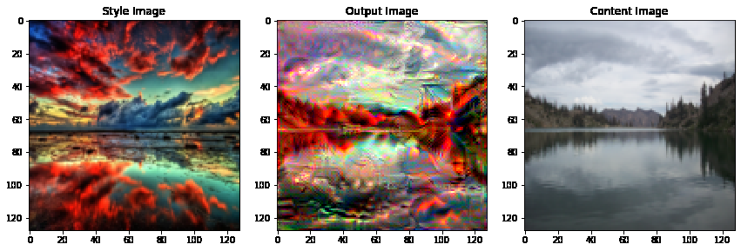
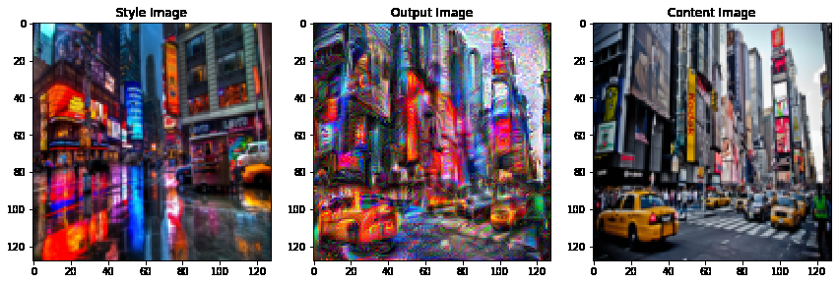
Results
The following results were obtained after running our model for 500 iterations.
A resolution of 128*128 was taken for all the input images to make it faster.

Slide 11
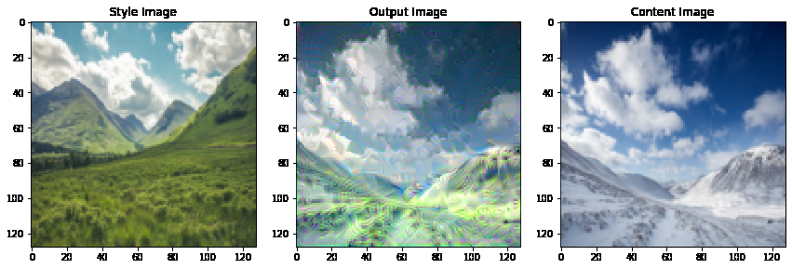
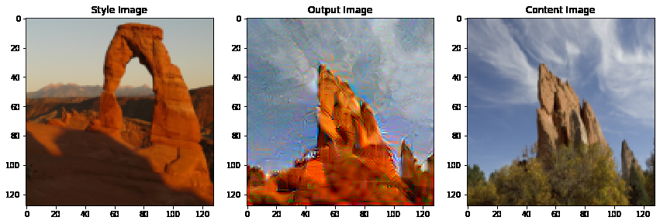

Slide 12
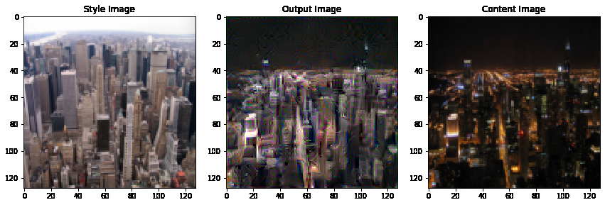
Results
The images were obtained after running for 1000 iterations.

Slide 13
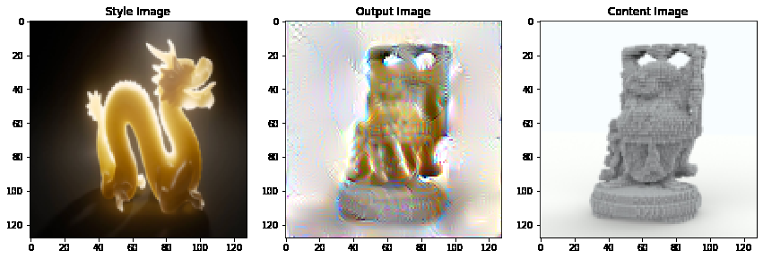
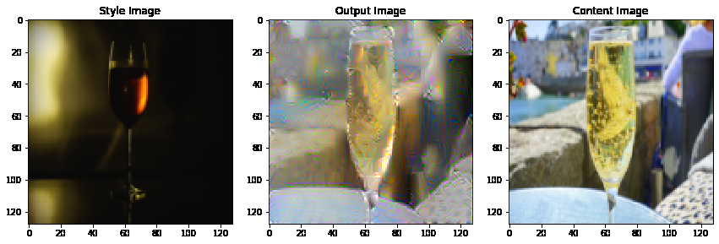

Slide 14
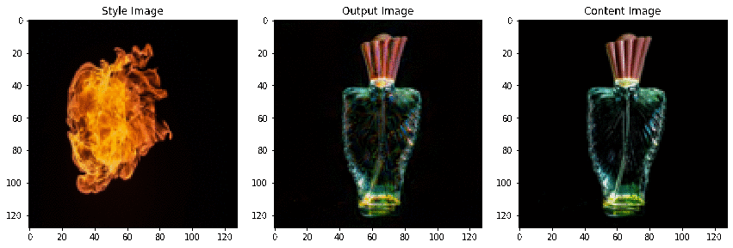
This style transfer was done for 3000 iterations. The video captures how the model builds the output image by minimising loss functions.

Slide 15
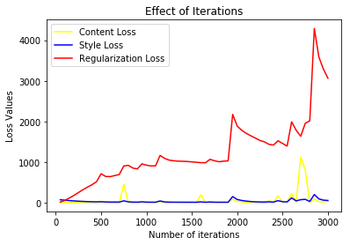
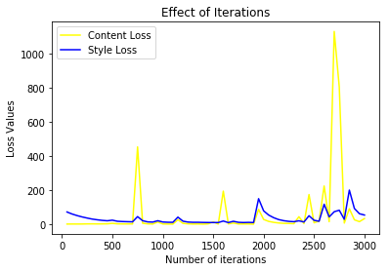
Effect of Iterations
From the graph it maybe concluded that the number of iterations increases to more than 2000, overfitting occurs for the before mentioned values of other parameters.

Slide 16
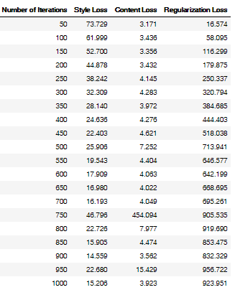
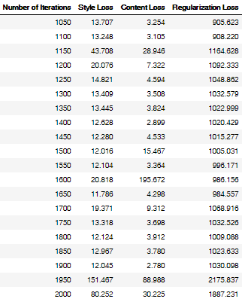
The table shows how the loss values change with the iterations.

Slide 17
References
Original Paper:
Luan, Fujun, et al. "Deep photo style transfer." Proceedings of the IEEE Conference on Computer Vision and Pattern Recognition. 2017.
Open Source Resources:
https://pytorch.org/tutorials/advanced/neural_style_tutorial.html
https://github.com/MarcoForte/closed-form-matting
https://github.com/LouieYang/deep-photo-styletransfer-tf

